Slide 1

Using Recursion
© 2010 Goodrich, Tamassia
Using Recursion
Notes:
Sequences

Slide 2
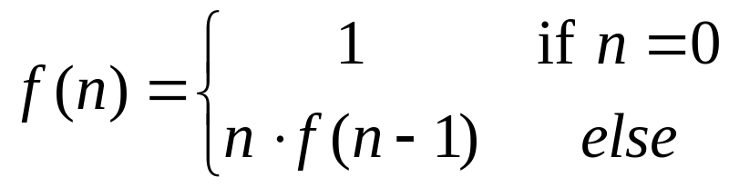
The Recursion Pattern
Recursion: when a method calls itself
Classic example--the factorial function:
  n! = 1· 2· 3· ··· · (n-1)· n
Recursive definition:
As a C++ method:
  // recursive factorial function
  int recursiveFactorial(int n) {
  if (n == 0) return 1; // basis case
  else return n * recursiveFactorial(n- 1); // recursive case
  }
© 2010 Goodrich, Tamassia
Using Recursion

Slide 3
Linear Recursion
Test for base cases
  Begin by testing for a set of base cases (there should be at least one).
  Every possible chain of recursive calls must eventually reach a base case, and the handling of each base case should not use recursion.
Recur once
  Perform a single recursive call
  This step may have a test that decides which of several possible recursive calls to make, but it should ultimately make just one of these calls
  Define each possible recursive call so that it makes progress towards a base case.
© 2010 Goodrich, Tamassia
Using Recursion

Slide 4
Example of Linear Recursion
Example recursion trace:
Algorithm LinearSum(A, n):
Input:
A integer array A and an integer n = 1, such that A has at least n elements
Output:
The sum of the first n integers in A
if n = 1 then
return A[0]
else
return LinearSum(A, n - 1) + A[n - 1]
call
return
15
+
A
[
4
] =
15
+
5
=
20
LinearSum
(
A
,
5
)
call
return
13
+
A
[
3
] =
13
+
2
=
15
LinearSum
(
A
,
4
)
call
return
7
+
A
[
2
] =
7
+
6
=
13
LinearSum
(
A
,
3
)
call
return
4
+
A
[
1
] =
4
+
3
=
7
LinearSum
(
A
,
2
)
call
return
A
[
0
] =
4
LinearSum
(
A
,
1
)
© 2010 Goodrich, Tamassia
Using Recursion

Slide 5
Reversing an Array
Algorithm ReverseArray(A, i, j):
Input: An array A and nonnegative integer indices i and j
Output: The reversal of the elements in A starting at index i and ending at j
if i < j then
Swap A[i] and A[ j]
ReverseArray(A, i + 1, j - 1)
return
© 2010 Goodrich, Tamassia
Using Recursion

Slide 6
Defining Arguments for Recursion
In creating recursive methods, it is important to define the methods in ways that facilitate recursion.
This sometimes requires we define additional paramaters that are passed to the method.
For example, we defined the array reversal method as ReverseArray(A, i, j), not ReverseArray(A).
© 2010 Goodrich, Tamassia
Using Recursion

Slide 7
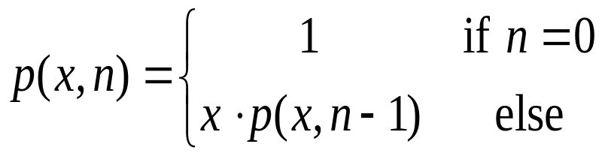
Computing Powers
The power function, p(x,n)=x^{n}, can be defined recursively:
This leads to an power function that runs in O(n) time (for we make n recursive calls).
We can do better than this, however.
© 2010 Goodrich, Tamassia
Using Recursion

Slide 8
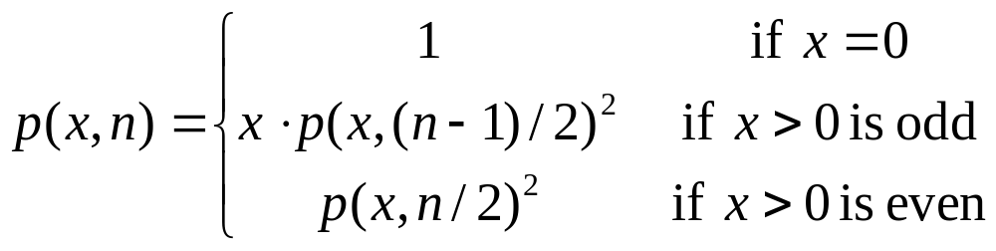
Recursive Squaring
We can derive a more efficient linearly recursive algorithm by using repeated squaring:
For example,
  2⁴ = 2^{(4/2)2} = (2^{4/2})² = (2²)² = 4² = 16
  2⁵ = 2^{1+(4/2)2} = 2(2^{4/2})² = 2(2²)² = 2(4²) = 32
  2⁶ = 2^{(6/ 2)2} = (2^{6/2})² = (2³)² = 8² = 64
  2⁷ = 2^{1+(6/2)2} = 2(2^{6/2})² = 2(2³)² = 2(8²) = 128.
© 2010 Goodrich, Tamassia
Using Recursion

Slide 9
Recursive Squaring Method
Algorithm Power(x, n):
Input: A number x and integer n = 0
Output: The value x^{n}
if n = 0 then
return 1
if n is odd then
y = Power(x, (n - 1)/ 2)
return x · y ·y
else
y = Power(x, n/ 2)
return y · y
© 2010 Goodrich, Tamassia
Using Recursion

Slide 10
Analysis
Algorithm Power(x, n):
Input: A number x and integer n = 0
Output: The value x^{n}
if n = 0 then
return 1
if n is odd then
y = Power(x, (n - 1)/ 2)
return x · y · y
else
y = Power(x, n/ 2)
return y · y
Each time we make a recursive call we halve the value of n; hence, we make log n recursive calls. That is, this method runs in O(log n) time.
It is important that we use a variable twice here rather than calling the method twice.
© 2010 Goodrich, Tamassia
Using Recursion

Slide 11
Tail Recursion
Tail recursion occurs when a linearly recursive method makes its recursive call as its last step.
The array reversal method is an example.
Such methods can be easily converted to non-recursive methods (which saves on some resources).
Example:
  Algorithm IterativeReverseArray(A, i, j ):
  Input: An array A and nonnegative integer indices i and j
  Output: The reversal of the elements in A starting at index i and ending at j
  while i < j do
    Swap A[i ] and A[ j ]
    i = i + 1
    j = j - 1
  return
© 2010 Goodrich, Tamassia
Using Recursion

Slide 12
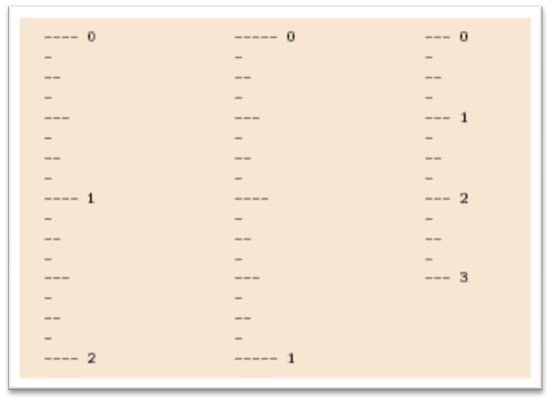
Binary Recursion
Binary recursion occurs whenever there are two recursive calls for each non-base case.
Example: the DrawTicks method for drawing ticks on an English ruler.
© 2010 Goodrich, Tamassia
Using Recursion

Slide 13
A Binary Recursive Method for Drawing Ticks
// draw a tick with no label
public static void drawOneTick(int tickLength) { drawOneTick(tickLength, - 1); }
// draw one tick
public static void drawOneTick(int tickLength, int tickLabel) {
for (int i = 0; i < tickLength; i++)
System.out.print("-");
if (tickLabel >= 0) System.out.print(" " + tickLabel);
System.out.print("\n");
}
public static void drawTicks(int tickLength) { // draw ticks of given length
if (tickLength > 0) { // stop when length drops to 0
drawTicks(tickLength- 1); // recursively draw left ticks
drawOneTick(tickLength); // draw center tick
drawTicks(tickLength- 1); // recursively draw right ticks
}
}
public static void drawRuler(int nInches, int majorLength) { // draw ruler
drawOneTick(majorLength, 0); // draw tick 0 and its label
for (int i = 1; i <= nInches; i++) {
drawTicks(majorLength- 1); // draw ticks for this inch
drawOneTick(majorLength, i); // draw tick i and its label
}
}
Note the two recursive calls
© 2010 Goodrich, Tamassia
Using Recursion

Slide 14
Another Binary Recusive Method
Problem: add all the numbers in an integer array A:
  Algorithm BinarySum(A, i, n):
  Input: An array A and integers i and n
  Output: The sum of the n integers in A starting at index i
  if n = 1 then
  return A[i ]
  return BinarySum(A, i, n/ 2) + BinarySum(A, i + n/ 2, n/ 2)
Example trace:
0
,
8
0
,
4
4
,
4
0
,
2
2
,
2
4
,
2
6
,
2
0
,
1
1
,
1
2
,
1
3
,
1
4
,
1
5
,
1
6
,
1
7
,
1
© 2010 Goodrich, Tamassia
Using Recursion

Slide 15
Computing Fibonacci Numbers
Fibonacci numbers are defined recursively:
    F₀ = 0
    F₁ = 1
    F_{i} = F_{i-1} ⁺ F_{i-2} for i > 1.
Recursive algorithm (first attempt):
      Algorithm BinaryFib(k):
      Input: Nonnegative integer k
      Output: The kth Fibonacci number F_{k}
      if k = 1 then
      return k
      else
      return BinaryFib(k - 1) + BinaryFib(k - 2)
© 2010 Goodrich, Tamassia
Using Recursion

Slide 16
Analysis
Let n_{k} be the number of recursive calls by BinaryFib(k)
  n₀ = 1
  n₁ = 1
  n₂ = n₁ + n₀ + 1 = 1 + 1 + 1 = 3
  n₃ = n₂ + n₁ + 1 = 3 + 1 + 1 = 5
  n₄ = n₃ + n₂ + 1 = 5 + 3 + 1 = 9
  n₅ = n₄ + n₃ + 1 = 9 + 5 + 1 = 15
  n₆ = n₅ + n₄ + 1 = 15 + 9 + 1 = 25
  n₇ = n₆ + n₅ + 1 = 25 + 15 + 1 = 41
  n₈ = n₇ + n₆ + 1 = 41 + 25 + 1 = 67.
Note that n_{k} at least doubles every other time
That is, n_{k} > 2^{k/2}. It is exponential!
© 2010 Goodrich, Tamassia
Using Recursion

Slide 17
A Better Fibonacci Algorithm
Use linear recursion instead
    Algorithm LinearFibonacci(k):
    Input: A nonnegative integer k
    Output: Pair of Fibonacci numbers (F_{k} , F_{k−1})
    if k = 1 then
    return (k, 0)
    else
    (i, j) = LinearFibonacci(k − 1)
    return (i +j, i)
LinearFibonacci makes k−1 recursive calls
© 2010 Goodrich, Tamassia
Using Recursion

Slide 18
Multiple Recursion
Motivating example:
  summation puzzles
    pot + pan = bib
    dog + cat = pig
    boy + girl = baby
Multiple recursion:
  makes potentially many recursive calls
  not just one or two
© 2010 Goodrich, Tamassia
Using Recursion

Slide 19
Algorithm for Multiple Recursion
Algorithm PuzzleSolve(k,S,U):
Input: Integer k, sequence S, and set U (universe of elements to test)
Output: Enumeration of all k-length extensions to S using elements in U without repetitions
for all e in U do
Remove e from U {e is now being used}
Add e to the end of S
if k = 1 then
Test whether S is a configuration that solves the puzzle
if S solves the puzzle then
return “Solution found: ” S
else
PuzzleSolve(k - 1, S,U)
Add e back to U {e is now unused}
Remove e from the end of S
© 2010 Goodrich, Tamassia
Using Recursion

Slide 20
Example
Slide by Matt Stallmann included with permission.
cbb + ba = abc
a,b,c stand for 7,8,9; not necessarily in that order
799 + 98 = 997
[] {a,b,c}
[a] {b,c}
a=7
[b] {a,c}
b=7
[c] {a,b}
c=7
[ab] {c}
a=7,b=8
c=9
[ac] {b}
a=7,c=8
b=9
[ca] {b}
c=7,a=8
b=9
[cb] {a}
c=7,b=8
a=9
[ba] {c}
b=7,a=8
c=9
[bc] {a}
b=7,c=8
a=9
might be able to
stop sooner
© 2010 Stallmann
Using Recursion

Slide 21
Visualizing PuzzleSolve
Initial call
PuzzleSolve
(
3
,
()
,{
a
,
b
,
c
}
)
PuzzleSolve
(
2
,
a
,{
b
,
c
}
)
PuzzleSolve
(
2
,
b
,{
a
,
c
}
)
PuzzleSolve
(
2
,
c
,{
a
,
b
}
)
PuzzleSolve
(
1
,
ab
,{
c
}
)
PuzzleSolve
(
1
,
ba
,{
c
}
)
PuzzleSolve
(
1
,
ca
,{
b
}
)
abc
bac
cab
PuzzleSolve
(
1
,
ac
,{
b
}
)
PuzzleSolve
(
1
,
bc
,{
a
}
)
PuzzleSolve
(
1
,
cb
,{
a
}
)
acb
bca
cba
© 2010 Goodrich, Tamassia
Using Recursion

